Slide 1



DEPI
NTER-BRANCH CONNECTIVITY
PROJECT
Presented by: Mohamed Goda
Merna Maged
Amr Ahmed

Slide 2

OVERVIEW
01
02
03
Project Overview
Network Design
Key Protocols and Technologies
04
05
Challenges and Solutions
Conclusion

Slide 3





PROJECT OVERVIEW
OBJECTIVE
TECHNOLOGIES
Routing: OSPF
Switching: VTP , STP , EtherChannel ,secuirty
Security: VPN ,ACLs
NAT: Network Address Translation
Management: Syslog Server,
WLAN: Wireless LAN support
DHCP server
The aim of this project is to design and implement a secure, scalable network infrastructure connecting two company branches. The network will ensure seamless communication, resource sharing, and high availability between both locations.

Slide 4





NETWORK DESIGN OVERVIEW
Topology Components:
01
Routers:
Two routers (left and right) with tunnel interfaces for VPN connectivity.
NAT configuration
04
End Devices:
PCs and phones connected to access switches and segmented by VLANs.
02
Distribution Switches:
Serve as the central switches in each branch, connecting to both routers and access switches.
Configured with EtherChannel for redundancy and link aggregation.
05
Servers:
Syslog server for logging network events and TFTP server for device configuration backups.
03
Access Switches:
Connected to distribution switches via EtherChannel for high availability.
VLANs configured on the access switches:
VLAN 10 (IT) for PCs.
VLAN 20 (Sales) for other devices like phones.
06
Wireless Access Points (WAPs):
Extending network coverage wirelessly
Enabling mobile device connectivity via WLAN (Wireless LAN)

Slide 5
NETWORK DESIGN OVERVIEW
Redundancy and Link Aggregation:
EtherChannel links between distribution and access switches for high availability and increased bandwidth.
Spanning Tree Protocol (STP) prevents network loops, but EtherChannel minimizes STP complexity by grouping links.
PortFast and BPDU Guard on end-device ports improve network startup time and security.
WAN Connectivity:
VPN Tunnel between routers (via Tunnel0) ensures secure communication between branches.
NAT configuration on routers for external network (internet) access.

Slide 6
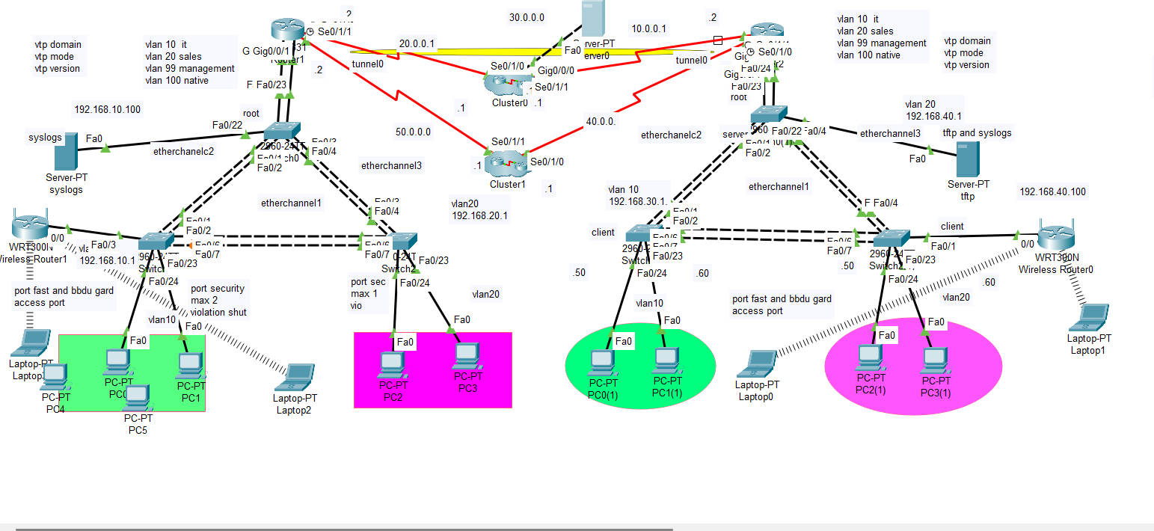

Slide 7

NETWORK PROTOCOLS
This project will employ Cisco networking devices and technologies, focusing on routing, switching, and security protocols

Slide 8

OSPF
OSPF (Open Shortest Path First):Purpose: Dynamic routing protocol used to share routing information between routers.
Usage in the Network:
Facilitates communication between routers and ensures efficient routing.
Ensures optimal path selection between the two branches.
January
February
March
VTP
Purpose: Simplifies management of VLANs across multiple switches by synchronizing VLAN information.
Usage in the Network:
Ensures consistent VLAN configurations on all switches.
Reduces manual configuration errors by centralizing VLAN information.
April
May

Slide 9
STP
Purpose: Prevents loops in a Layer 2 network by blocking redundant paths.
Usage in the Network:
Ensures a loop-free network topology while providing backup paths if a link fails.
Used in tandem with EtherChannel to optimize path selection and redundancy.
January
February
March
ETHERCHANNEL
Purpose: Bundles multiple physical links into a single logical link for increased bandwidth and redundancy.
Usage in the Network:
Implemented between distribution and access switches.
Provides load balancing and redundancy, allowing for automatic failover in case one link goes down.
April
May

Slide 10
VPN
Purpose: Securely connects the two branches over the internet.
Usage in the Network:
VPN Tunnel (Tunnel0) ensures encrypted communication between the two branches.
Protects sensitive data while traveling between locations.
January
February
March
NAT
Purpose: Translates private IP addresses to public IP addresses for devices accessing the internet.
Usage in the Network:
Configured on the routers to allow internal devices to access external networks .
Ensures that internal network addresses remain hidden from the public
April
May

Slide 11
DHCP
Purpose: Automatically assigns IP addresses and network configuration settings to devices.
Usage in the Network:
Simplifies IP address management, ensuring dynamic and efficient allocation of addresses in both wired and wireless networks.
January
February
March
HSRP
Purpose: Provides network redundancy by allowing multiple routers to share a virtual IP address, ensuring continuous availability in case the primary router fails.
Usage in the Network:
Ensures high availability and automatic failover in case the active router becomes unavailable.
April
May

Slide 12
SYSLOG
Purpose: Collects and logs network events for monitoring and troubleshooting.
Usage in the Network:
Centralized logging server (Syslog) used to record important events from routers and switches.
Helps in monitoring network health and diagnosing issues.
January
February
March
FTP server
Purpose: Provides a platform for file sharing and configuration backups between network devices.
Usage in the Network:
TFTP and configuration file backups.
Can also be used for upgrading firmware and software on devic
April
May

Slide 13



CHALLENGES AND SOLUTIONS
Network Scalability
Security Concerns
Challenge: Ensuring the network can accommodate future growth without significant redesign.
Solution:
Implementing a hierarchical network design that separates layers (core, distribution, access).
Using VLANs and EtherChannel to optimize bandwidth and allow for easy expansion.
Challenge: Protecting sensitive data during transmission between branches.
Solution:
Implementing VPN for secure communication between sites.
Configuring access control lists (ACLs) on routers to restrict unauthorized access.
configure switches security

Slide 14


CHALLENGES AND SOLUTIONS
Network Performance
Redundancy and Reliability
Challenge : Ensuring optimal performance during peak usage times.
Solution:
Regular monitoring of network performance using Syslog and other tools.
Adjusting configurations and allocating resources based on traffic analysis.
Challenge: Ensuring continuous network availability and minimizing downtime.
Solution:
Device Redundancy: Deploy multiple routers and switches; use HSRP for failover.
Link Redundancy: Implement EtherChannel and STP for loop prevention and failover.
backup ISPs

Slide 15


CONCLUSION
the network design project successfully established a robust and scalable infrastructure connecting two company branches, leveraging Cisco technologies to facilitate seamless communication and resource sharing. Through the implementation of routing protocols such as OSPF, VPNs for secure connectivity, and redundancy measures, the network demonstrated high availability and performance with minimal latency and packet loss. The thorough testing and validation processes highlighted the effectiveness of the design .

Slide 16


DEPI
Thank's For Watching

